Slide 1
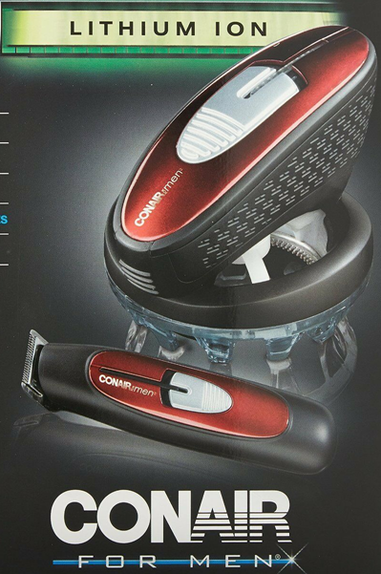
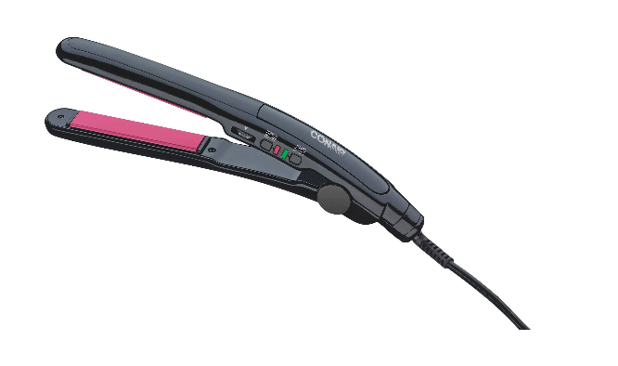
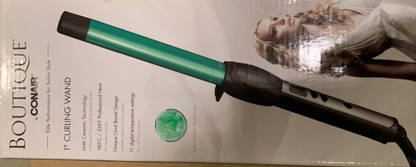
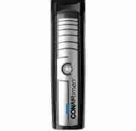
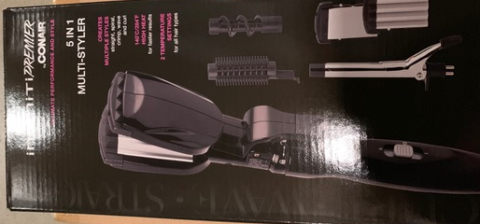
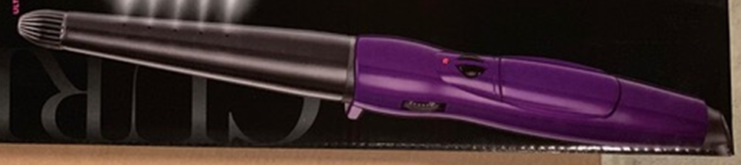
CONAIR HAIR STYLING PRODUCTS
Even Cut Lithium Ion Rotary Hair Clipper w/ Trimmer
with Dual Voltage
Model MCT7565RL1C-CTXC
UPC: 68459140494 qty: 12,900 pcs
Boutique 1" Jade Curling Wand
Model CD21615DMC
UPC: 68459139160 qty: 1,436 pcs
Infinity Premier 3/4" Dual Voltage Straightener Model CS2255DMC
UPC: 68459139443 qty: 1,527 pcs
Infinity Premier 5-in-1MultiStyler Model CB6005DMC
UPC: 68459138330 qty: 1,687 pcs
Infinity Premier 1 1/4 Steam Curling Wand
Model CD1245DMC
UPC: 68459158147 qty: 3571 pcs
Lithium Ion Multi Head Trimmer Dual Voltage
Model GMT74215DMC
UPC: 68459119162 qty: 3,499 pcs

